Slide 1
Nucleic Acid
Dr Nikunj Bhatt

Slide 2
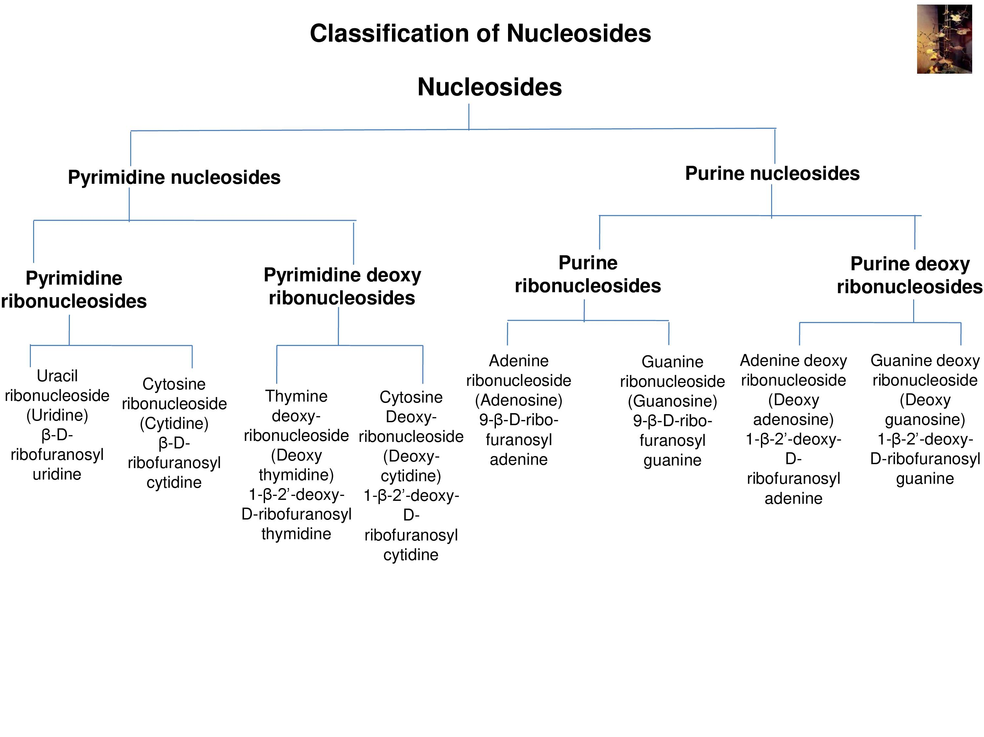

Slide 3
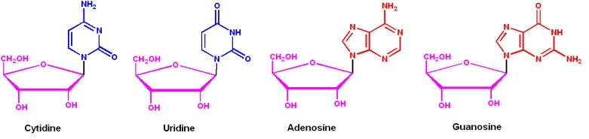
Nucleoside

Slide 4
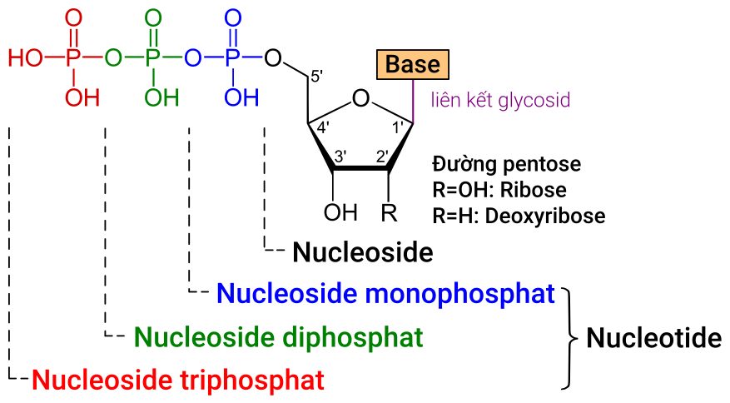
Nucleotides

Slide 5
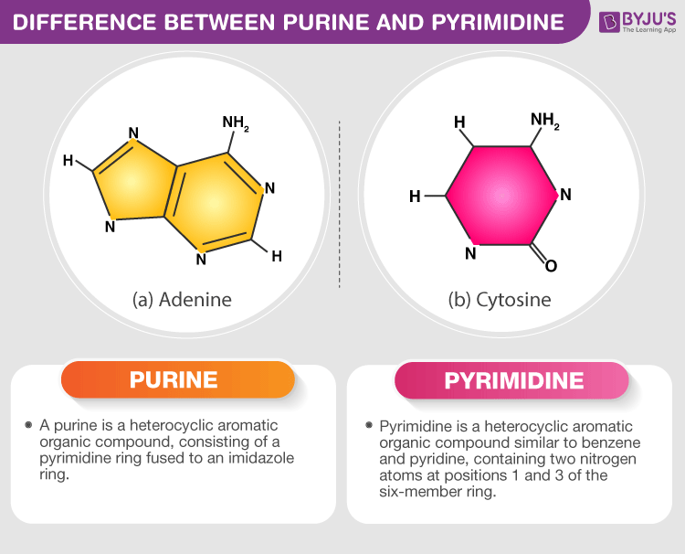
Purines and Pyrimidine

Slide 6
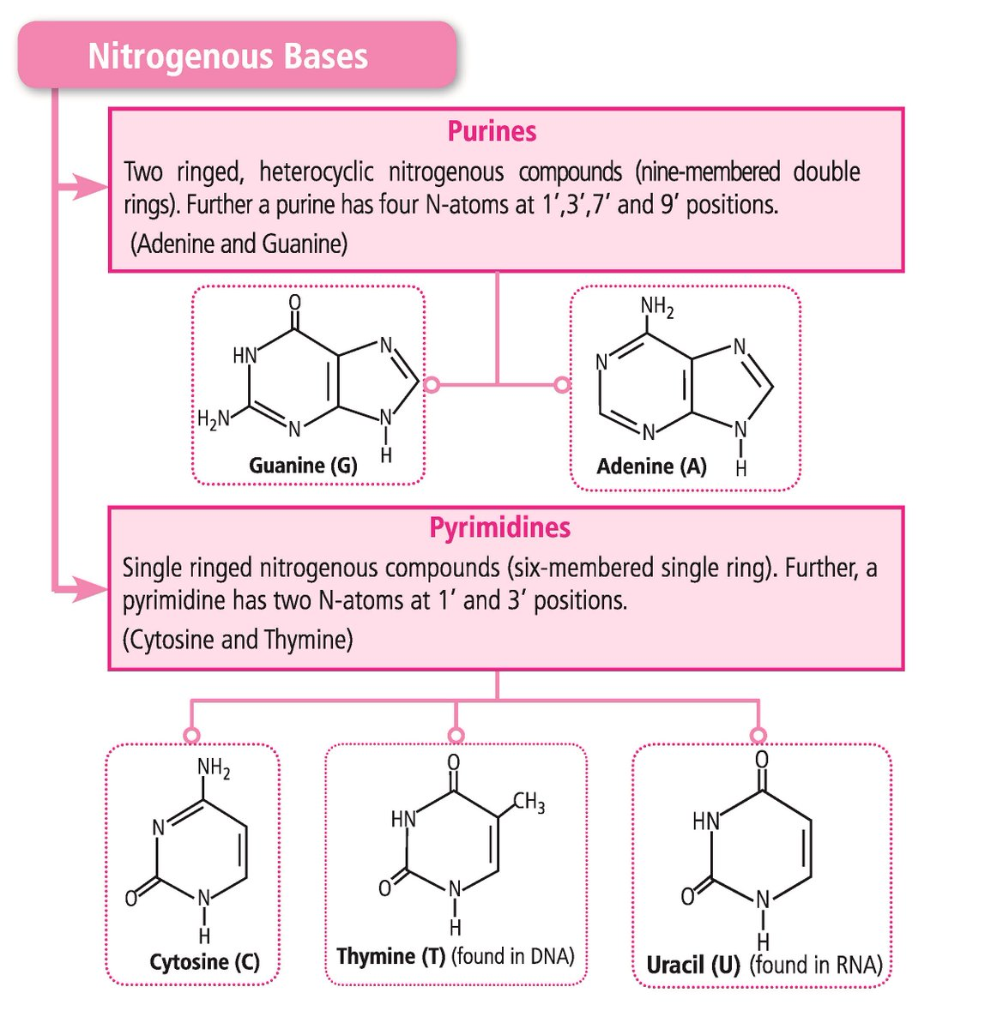
Purines and Pyrimidine

Slide 7
Biosynthesis
Biosynthesis is a multi-step, enzyme-catalyzed process where substrates are converted into more complex products in living organisms.
In biosynthesis, simple compounds are modified, converted into other compounds, or joined together to form macromolecules.
This process often consists of metabolic pathways.
The purines are built upon a pre-existing ribose 5- phosphate.
Liver is the major site for purine nucleotide synthesis.
Erythrocytes, polymorphonuclear leukocytes & brain cannot produce purines.

Slide 8
There are Two pathways for the synthesis of nucleotides:
De-novo synthesis: Biochemical nucleotides are synthesized from new simple precursor molecules
Salvage pathway: Used to recover bases
And nucleotides form during the degradation of RNA and DNA

Slide 9
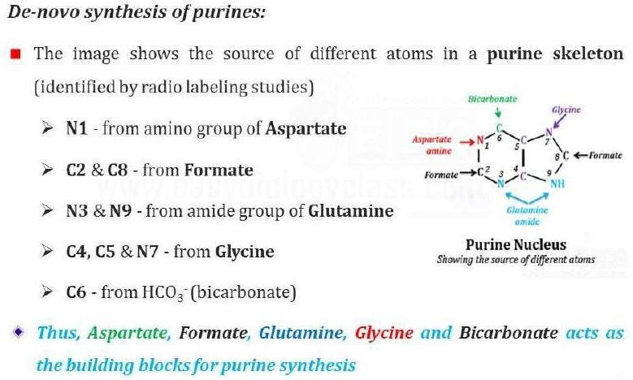
Biosynthesis Purines

Slide 10
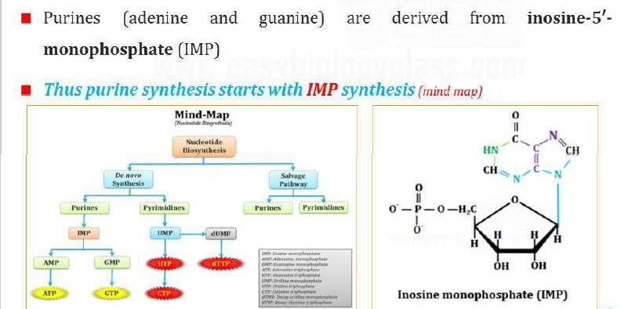
Biosynthesis

Slide 11
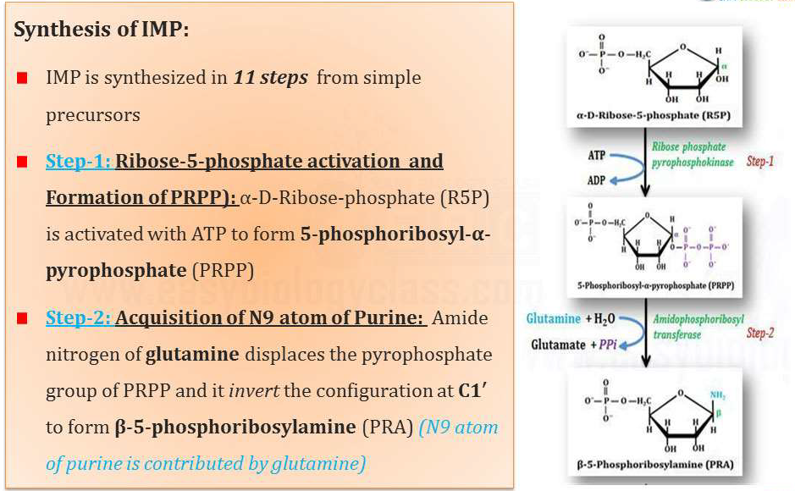

Slide 12
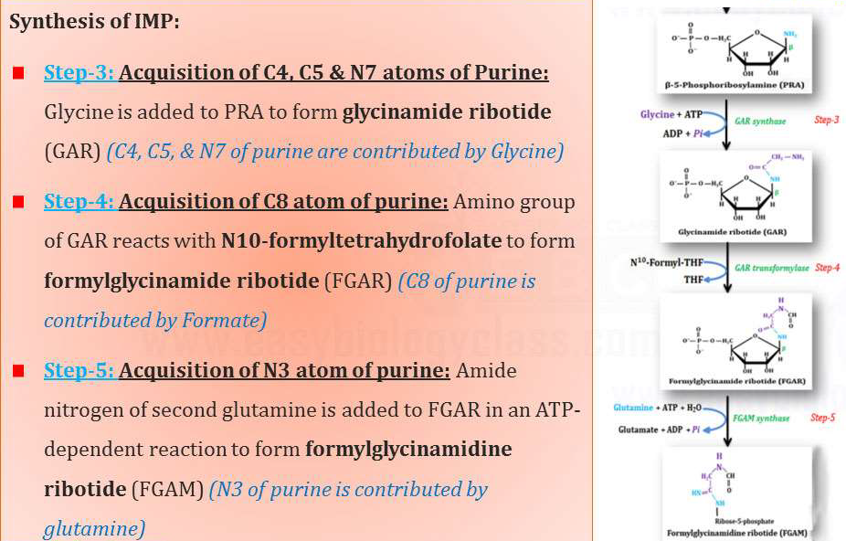

Slide 13
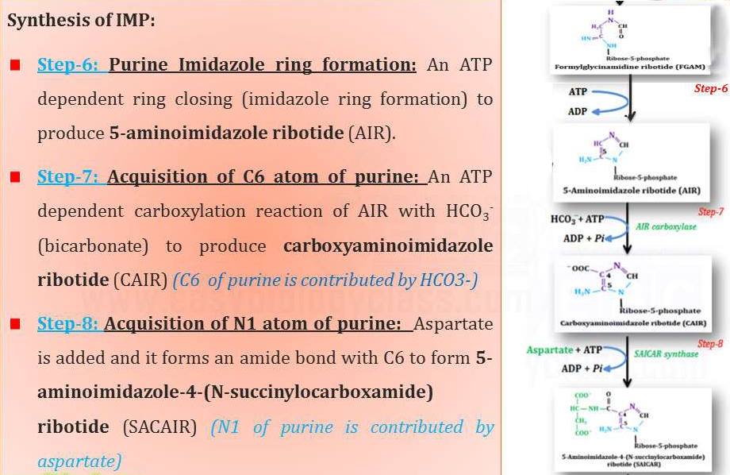

Slide 14
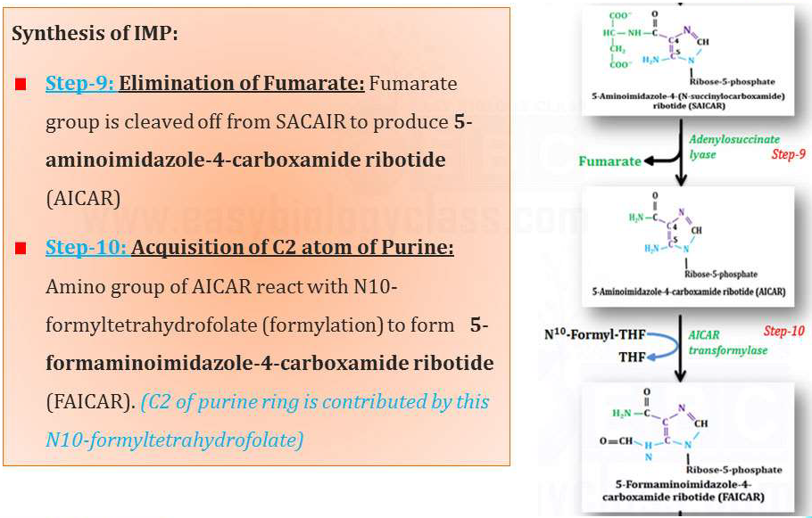

Slide 15
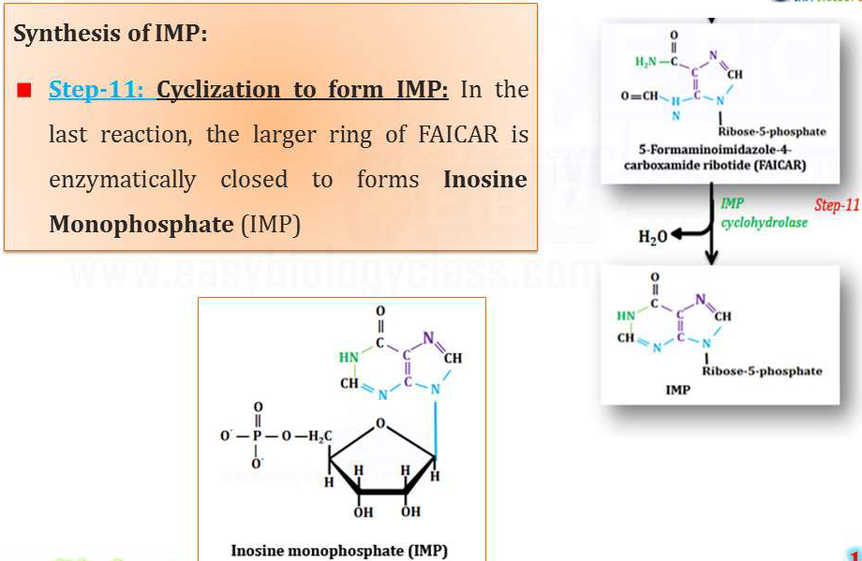

Slide 16
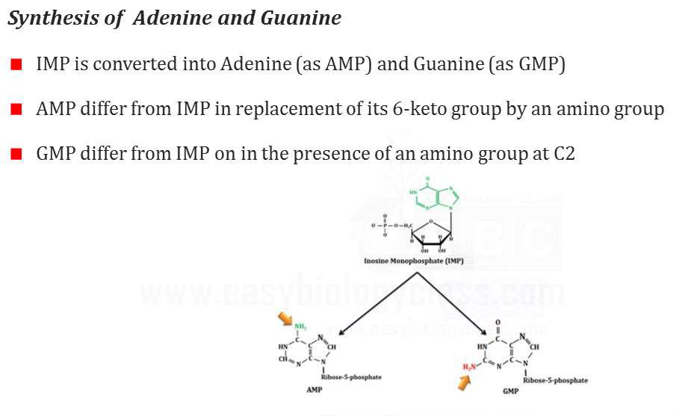

Slide 17
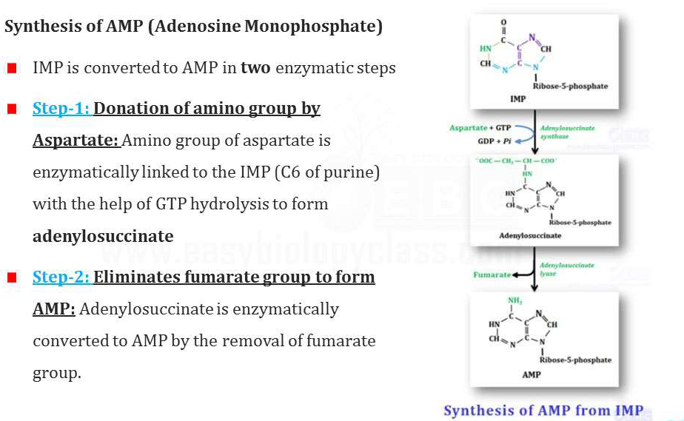

Slide 18
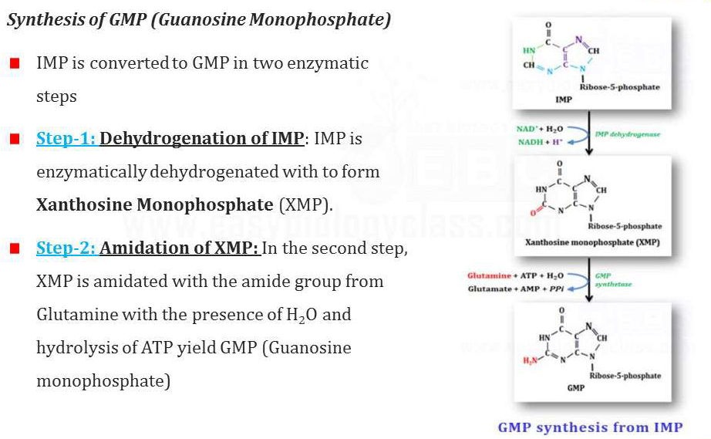

Slide 19
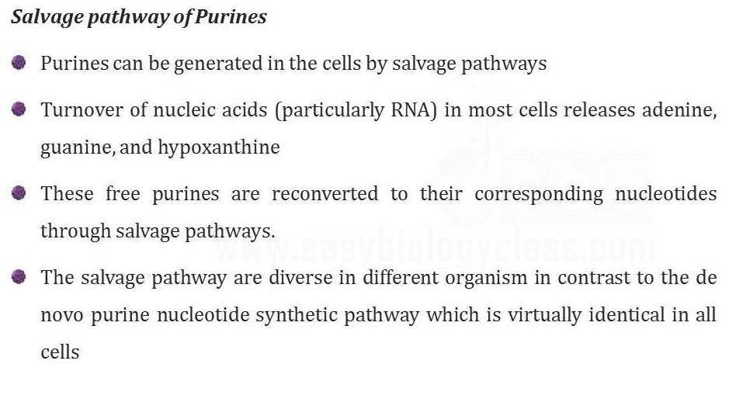

Slide 20
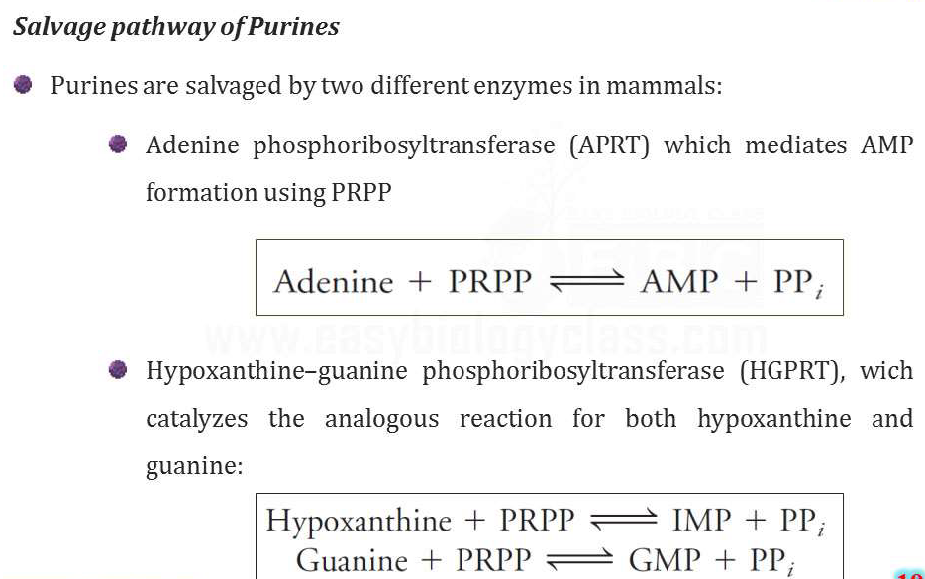

Slide 21
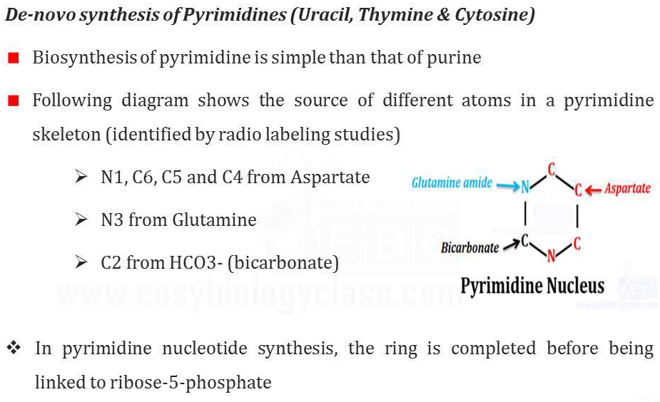
Steps in Pyrimidine biosynthesis

Slide 22
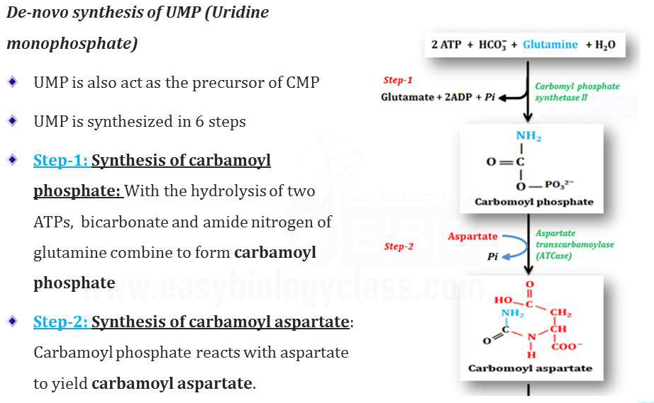
Biosynthesis

Slide 23
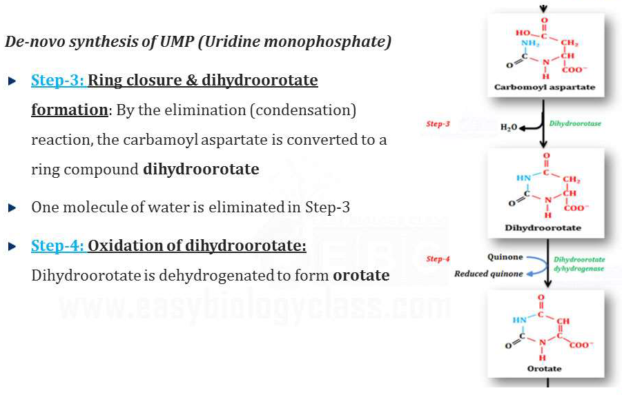

Slide 24
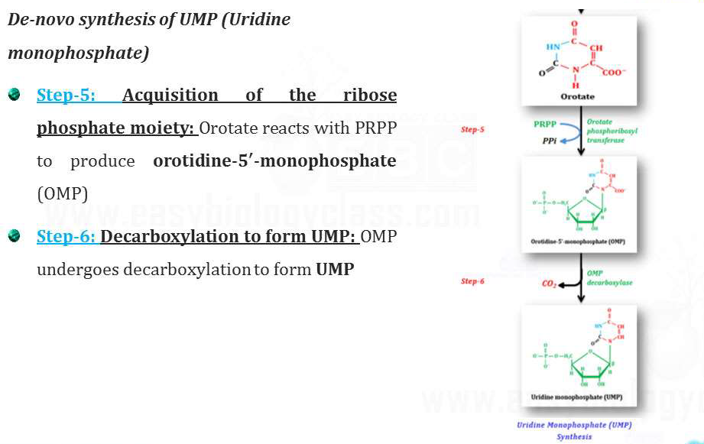

Slide 25
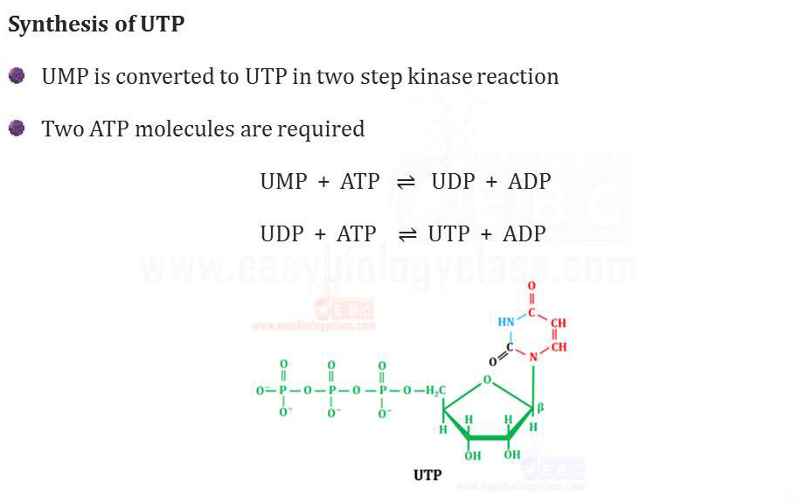

Slide 26
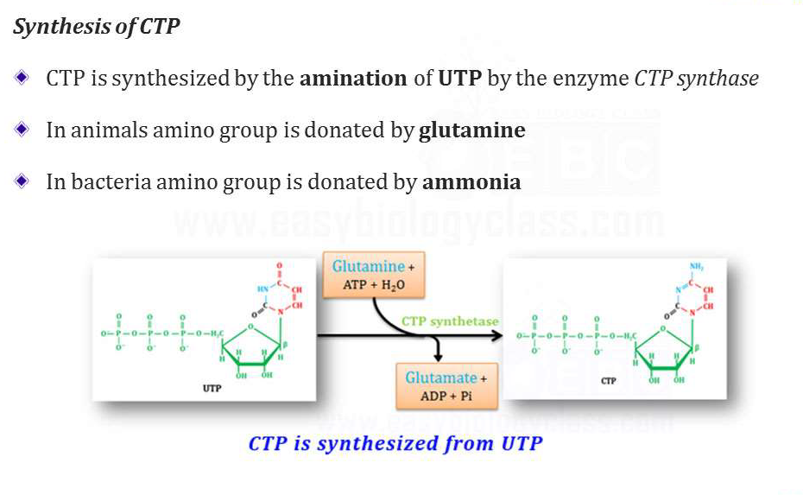

Slide 27
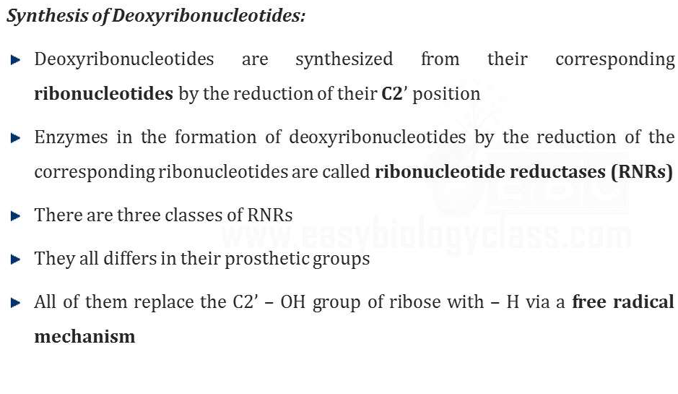

Slide 28
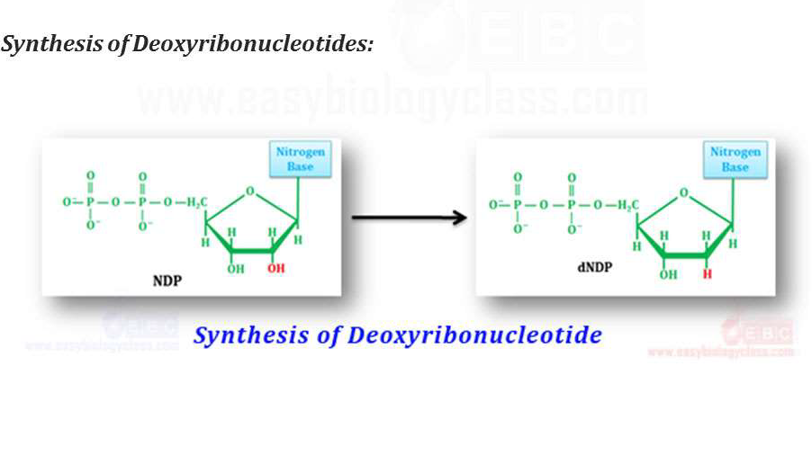

Slide 29
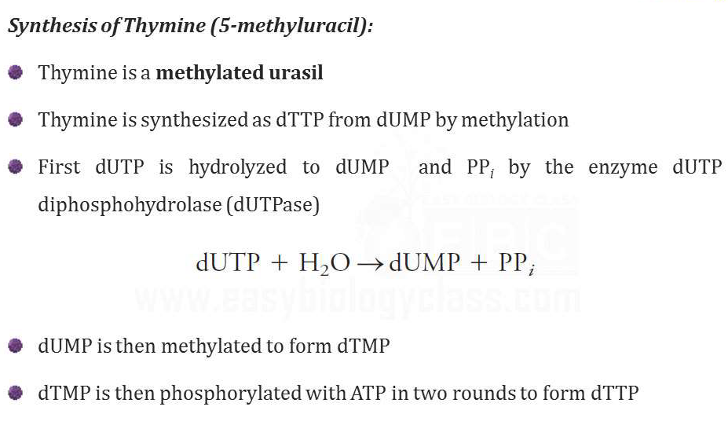

Slide 30
